Slide 1
Lab 2
INFO 201

Slide 2
Question about HW?
How did Assignment 2 go?
How do you feel about Assignment 3?
Use Modules, Google, Each other, and TAs if you have questions.

Slide 3
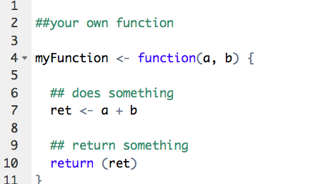
R recap
Functions: (reference module 6)
Allows you to encapsulate code to be reused by calling function’s name
Can take in parameters and return value

Slide 4
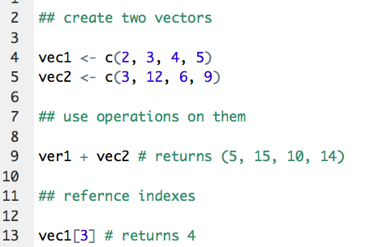
Recap cont.
Vectors: (reference module 7)
Store a similar set of data, at indexed points
Vectors can use operands with other vectors (+, -, * , /)

Slide 5
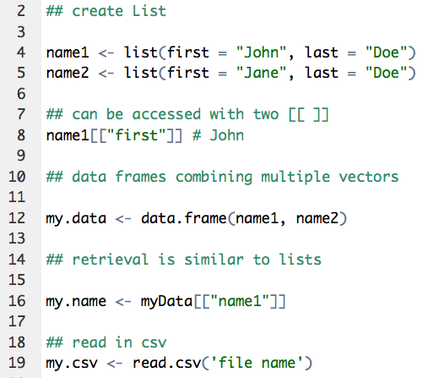
List/Data Frames
Lists allow you to store elements of different types and to associate them with a name.
Data frames can be created by combining multiple lists or reading in a csv file
(Reference Module 8)

Slide 6
Your Turn
Go to Module 8 fork and clone
Work on exercise 7
You will be reading in csv files and working with data frames

